Slide 1
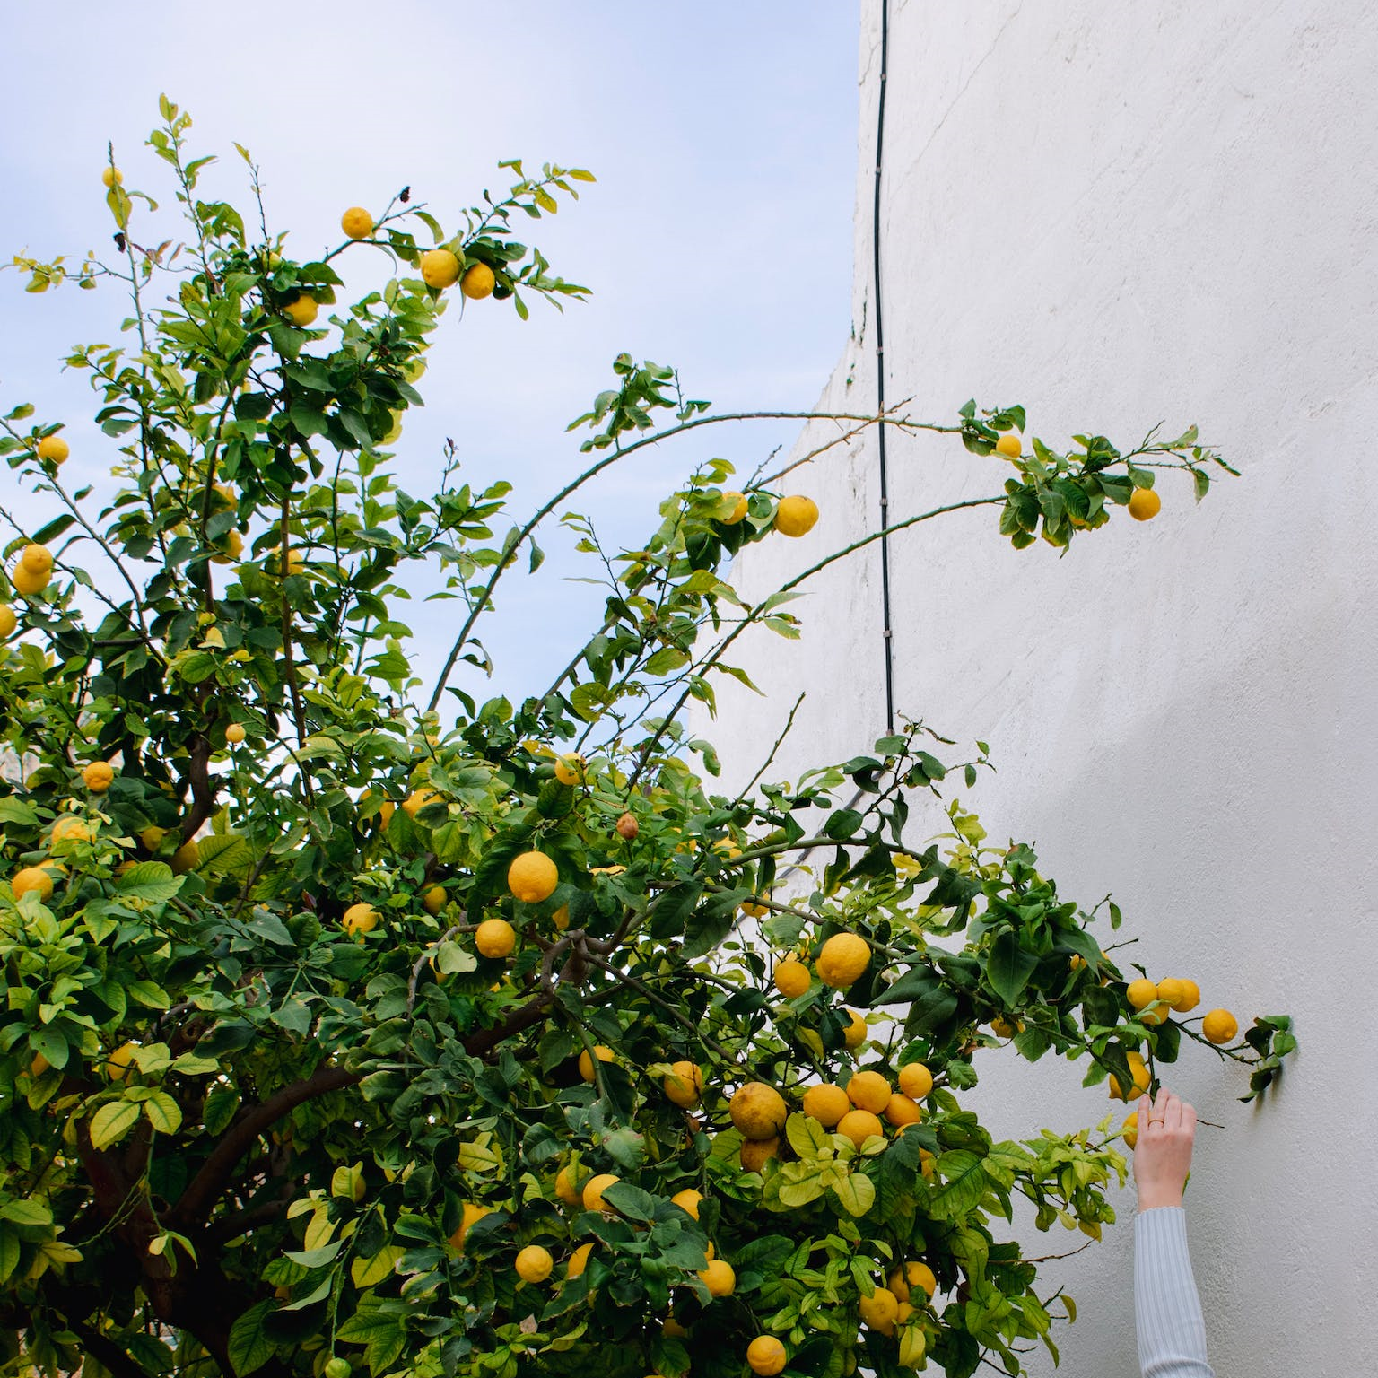
CSYE 7105
Team 13
Parallelizing Plant Health
A Comparative Study of Parallel Deep Learning for Plant Disease Classification
He Zhou
Weiyu Wang

Slide 2
Outline
Introduction
Methodology
Dataset Description
Result & Analysis
Conclusion
1
2
3
4
5
Background
Motivation
Goals
Roadmap
Mechanism
Tools
Overview
Splitting
EDA
Pre-processing
Pre-training
Hyperparameter tuning
Final Evaluation
How does parallelism perform in each phase?

Slide 3
1 Introduction
1.1 Background
How much economic loss do plant diseases cause each year?

Slide 4
1 Introduction
1.1 Background
$220 billion annually
according to the Food and Agriculture Organization of the United Nations
developing countries, small stakeholders…

Slide 5
1 Introduction
1.2 Motivation & goal
Motivation
Achieve timely disease identification
Datasets are huge, Trainings are slow - facing the challenge of the large image datasets
Goal
Accelerate the training by leveraging the power of parallel techniques
Compare the time efficiency of serial and parallel deep learning, analyze the potential benefits of parallel approaches.

Slide 6
2 Methodology
Roadmap
Step | Roadmap | Focuses | Tools | Parallelization Comparison
1 | Exploratory Data Analysis | Number of classes | NumPy, Matplotlib
2 | Data Preprocessing | Mean, std calculation for dataset normalization | (1) Dask Scheduler (2) PyTorch | √
3 | Model Definition | Resnet18 | Torchvision
4 | Model Pretraining | (1) Train on an initial set of hyperparameters on small number of epochs (2) Compare time efficiency between serial and parallel techniques | PyTorch (1) Serial (2) Using multi-process (num_workers) (3) Using multi-thread (DataParallel) | √
5 | Hyperparameter Tuning | Bayesian optimization | Optuna | √
6 | Final Training and Model Evaluation | Use optimized hyperparameters on extended epochs accuracy, precision, recall, and F1 score, confusion matrix | PyTorch Scikit-learn, Seaborn

Slide 7
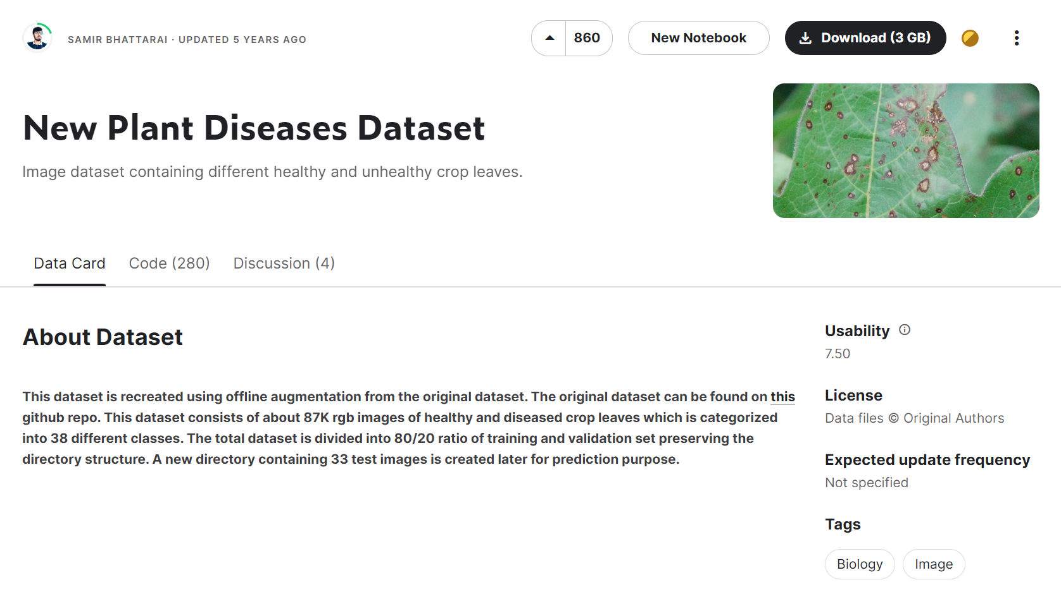
3 Dataset Description
3.1 Overview
Total size:
1.43 GB, contains 87.9k images
Dataset after splitting:
Subset | Image counts | Percent
train | 61494 | 70%
valid | 17572 | 20%
test | 8814 | 10%
Total | 87880 | 100%
Source:
https://www.kaggle.com/datasets/vipoooool/new-plant-diseases-dataset

Slide 8
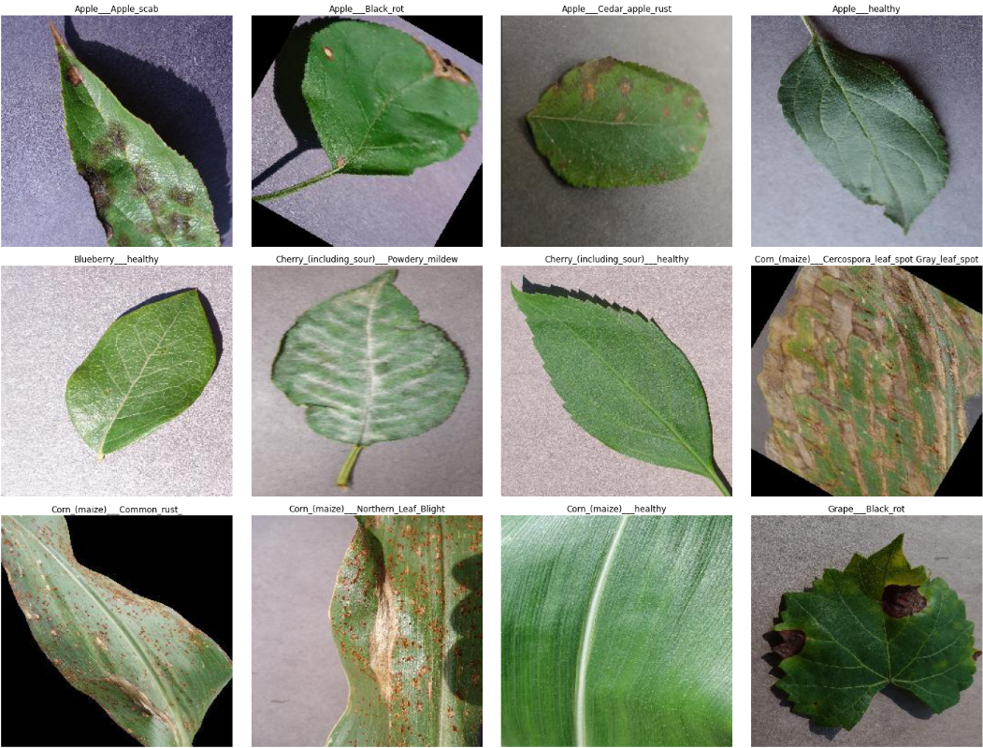
3 Dataset Description
3.2 Exploratory Data Analysis

Slide 9
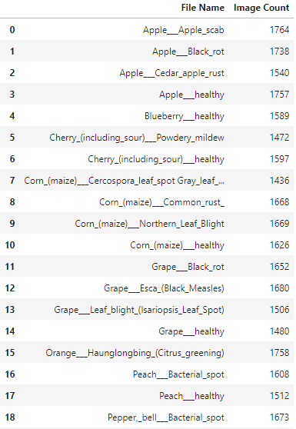
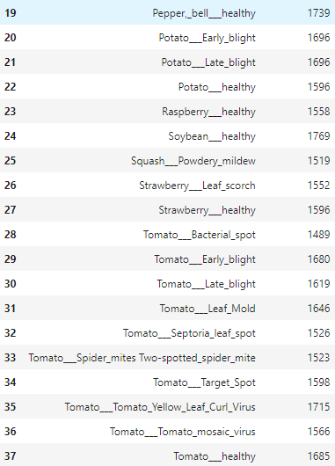
3 Dataset Description
3.2 Exploratory Data Analysis
The dataset is organized into 38 distinct categories based on plant species and specific diseases. Among these categories, there are 14 distinct plant categories and 26 types of plant diseases.
14 Plant Categories: Apple, Blueberry, Cherry, Corn, Grape, Orange, Peach, Pepper, Potato, Raspberry, Soybean, Squash, Strawberry, Tomato.

Slide 10
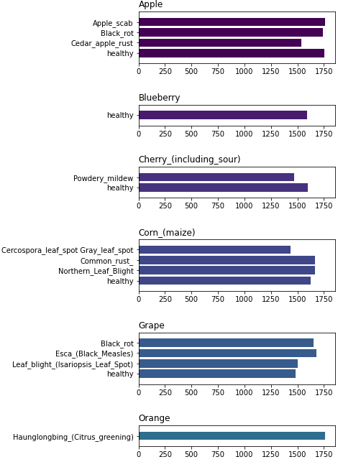
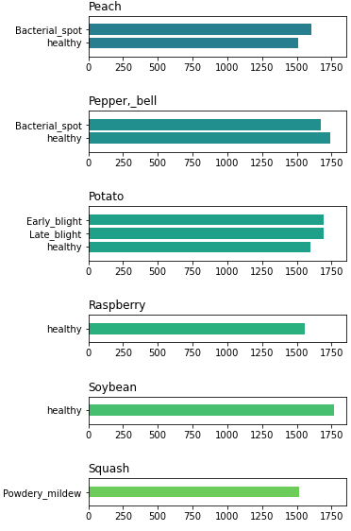
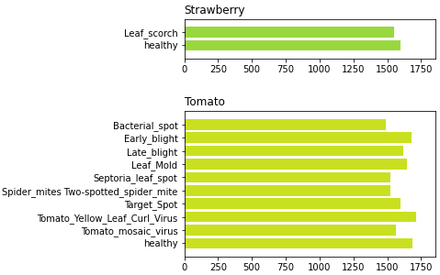
3 Dataset Description
3.2 Exploratory Data Analysis
The dataset is organized into 38 distinct categories based on plant species and specific diseases. Among these categories, there are 14 distinct plant categories and 26 types of plant diseases.
14 Plant Categories: Apple, Blueberry, Cherry, Corn, Grape, Orange, Peach, Pepper, Potato, Raspberry, Soybean, Squash, Strawberry, Tomato.

Slide 11
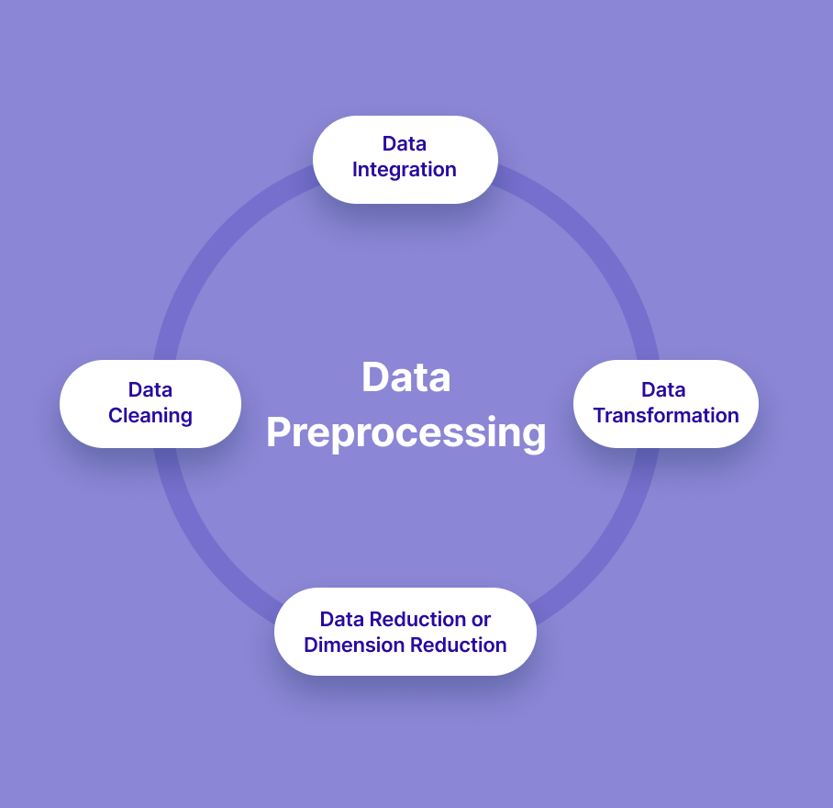
4 Result & Analysis
4.1 Data Preprocessing
Data Cleaning: Identify or delete dirty image data and control image data pixel consistency.
Import all the crucial libraries:
import os
import dask
import dask.array as da from skimage.io
import imread import numpy as np
Data Transformation:
Read the image and convert it to an array of values.
Convert an image to a PyTorch tensor using transforms.Compose.
Data Normalization: Calculate mean and Standard Deviation
Classic ImageNet statistics:
mean = [0.485, 0.456, 0.406]
std = [0.229, 0.224, 0.225]

Slide 12
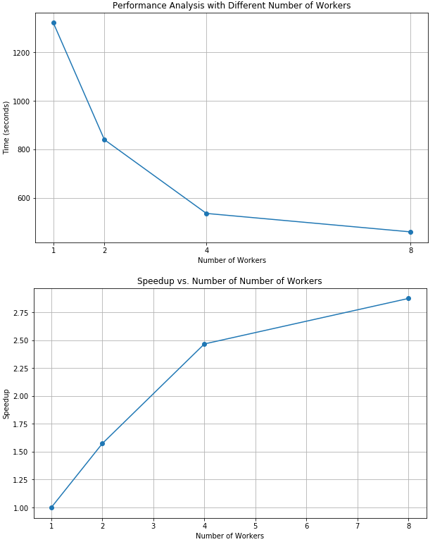
4 Result & Analysis
Using Dask
4.1 Data Preprocessing
Workers | Time(s) | Speed-up
1 | 1321.3 | 1
2 | 840.0 | 1.57
4 | 526.0 | 2.47
8 | 459.9 | 2.87

Slide 13
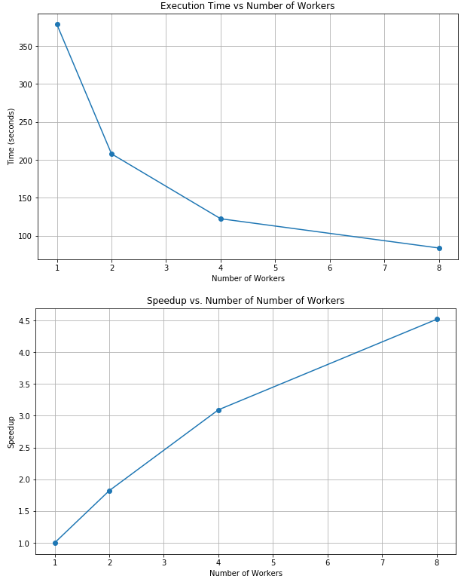
4 Result & Analysis
Using PyTorch
4.1 Data Preprocessing
Workers | Time(s) | Speed-up
1 | 378.3 | 1
2 | 207.8 | 1.82
4 | 122.3 | 3.09
8 | 83.7 | 4.52

Slide 14
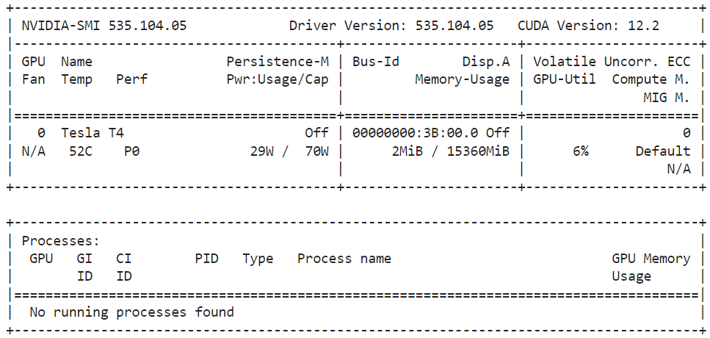
4 Result & Analysis
Serial Training
4.2 Pre-training
Hardware
CPU
Intel(R) Xeon(R) Gold 6240 CPU @ 2.60GHz
Architecture: X86_64
Count: 4 (1 processes)
GPU
Tesla T4
Count: 1

Slide 15
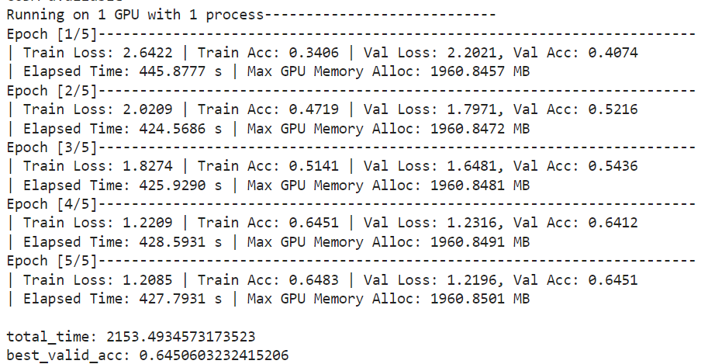
4 Result & Analysis
Serial Training
4.2 Pre-training
Progress

Slide 16
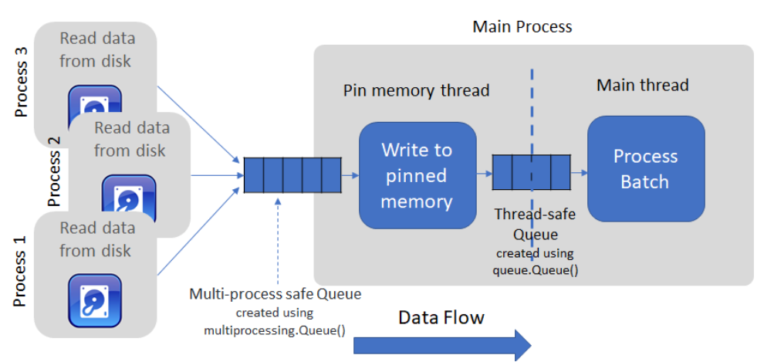
4 Result & Analysis
Using Multi-process (workers)
4.2 Pre-training
Parallel Mechanism
Multi workers in DataLoader
It uses multiple processes to load and process batch data from the disk into memory and puts it into a queue.
The main training process then consumes batches from this queue, reducing the overall time taken for each training iteration.

Slide 17
4 Result & Analysis
Using Multi-process (workers)
4.2 Pre-training
Hardware
CPU
Intel(R) Xeon(R) Gold 6240 CPU @ 2.60GHz
Architecture: X86_64
Count: 4 (2, 4, 8 processes)
GPU
Tesla T4
Count: 1

Slide 18
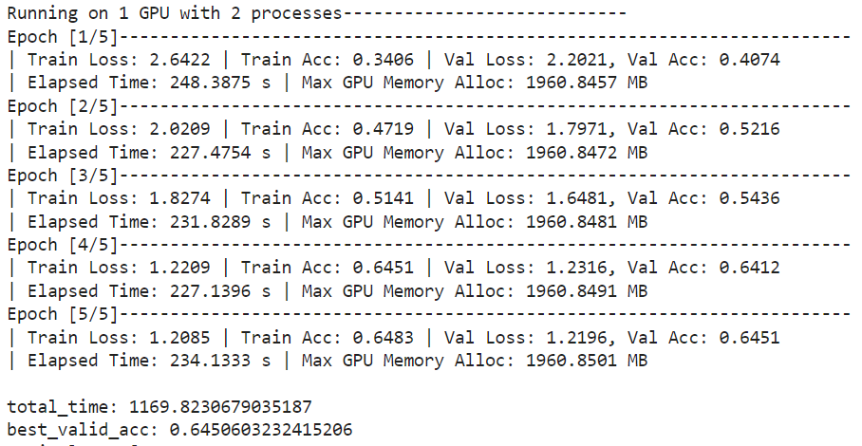
4 Result & Analysis
Using Multi-process (workers)
2
processes
4.2 Pre-training
Progress

Slide 19

4 Result & Analysis
Using Multi-process (workers)
4
processes
4.2 Pre-training
Progress

Slide 20
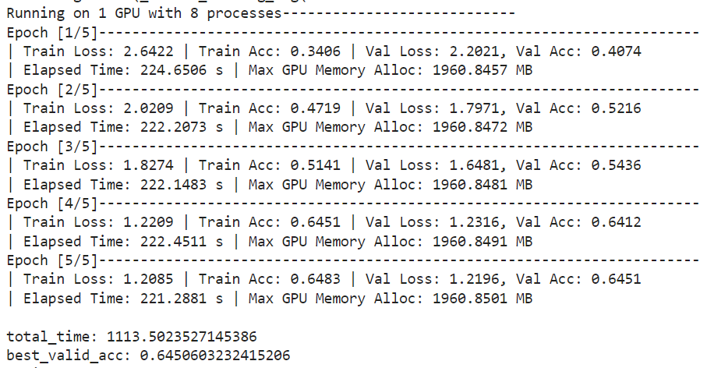
4 Result & Analysis
Using Multi-process (workers)
8
processes
4.2 Pre-training
Progress
over-subscription
Warning

Slide 21
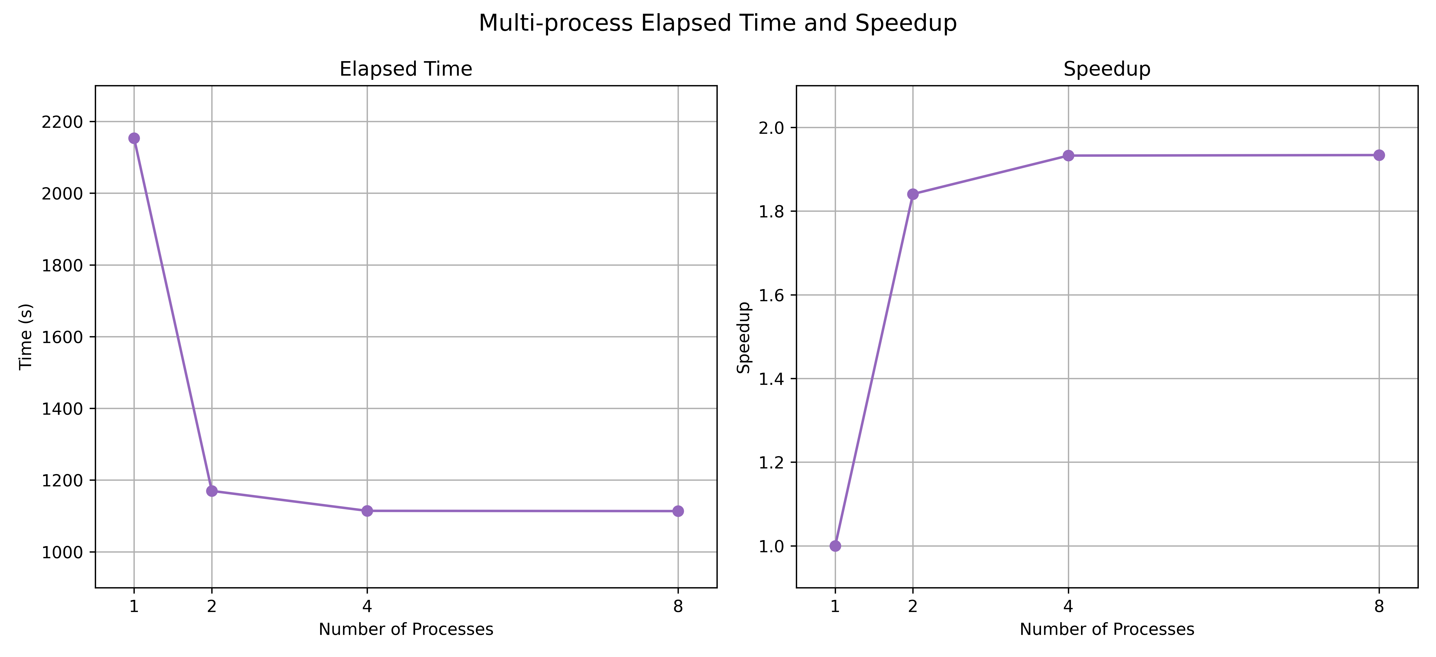
4 Result & Analysis
Count of Process | Elapsed time (s) | Speedup
Serial (1 process) | 2153.4935 | 1
2 processes | 1169.8231 | 1.8409
4 processes | 1114.2052 | 1.9328
8 processes | 1113.5024 | 1.9340
Using Multi-process (workers)
4.2 Pre-training
Comparison

Slide 22
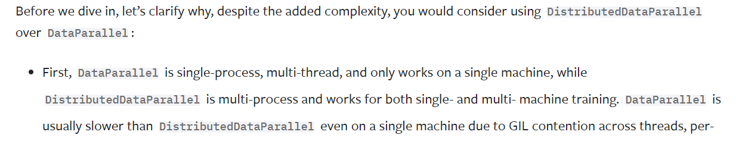
4 Result & Analysis
Using Multi-thread (DataParallel)
4.2 Pre-training
Parallel Mechanism
Distribute the input data and the model across multiple GPUs
Compute the forward and backward passes on each GPU
Aggregate the results to update the model parameters

Slide 23
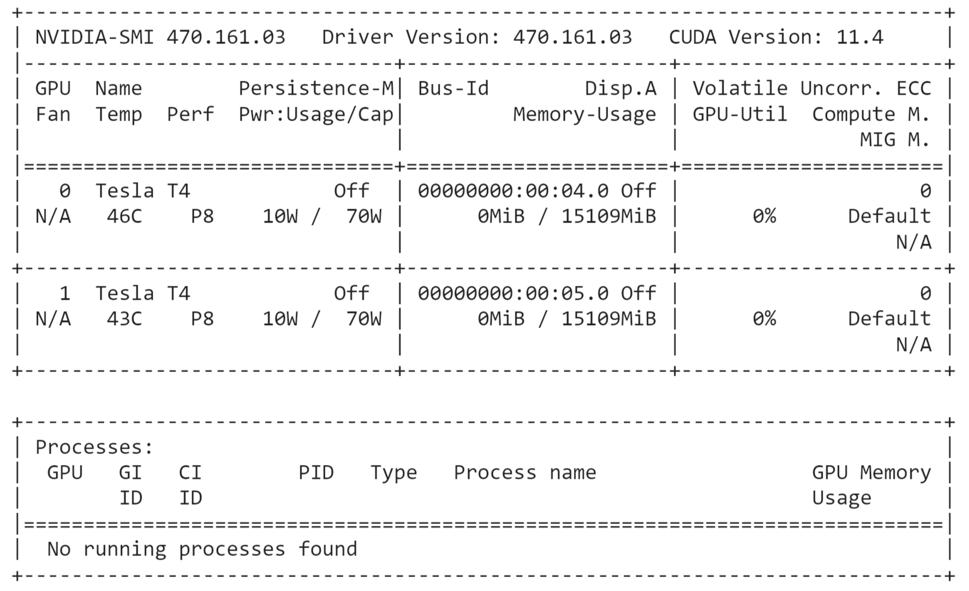
4 Result & Analysis
Using Multi-thread (DataParallel)
4.2 Pre-training
Hardware
CPU
Intel(R) Xeon(R) Gold 6240 CPU @ 2.60GHz
Architecture: X86_64
Count: 4
GPU
Tesla T4
Count: 2, 4(expected)

Slide 24
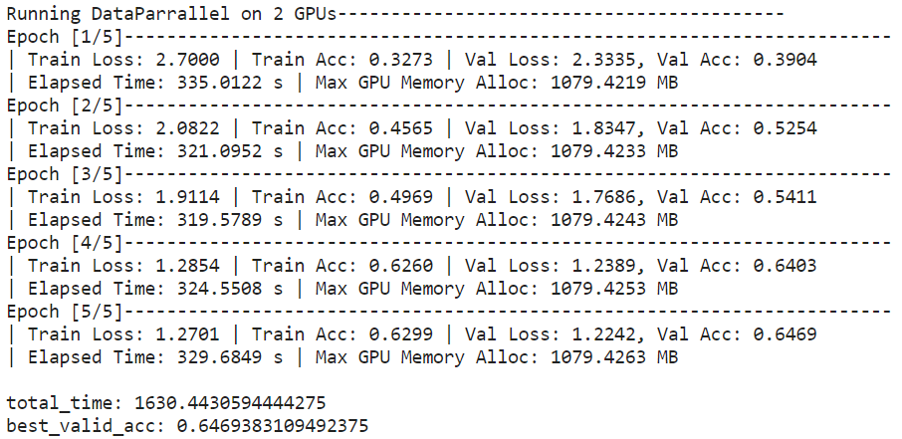
4 Result & Analysis
Using Multi-thread (DataParallel)
GPU
2
4.2 Pre-training
Progress

Slide 25
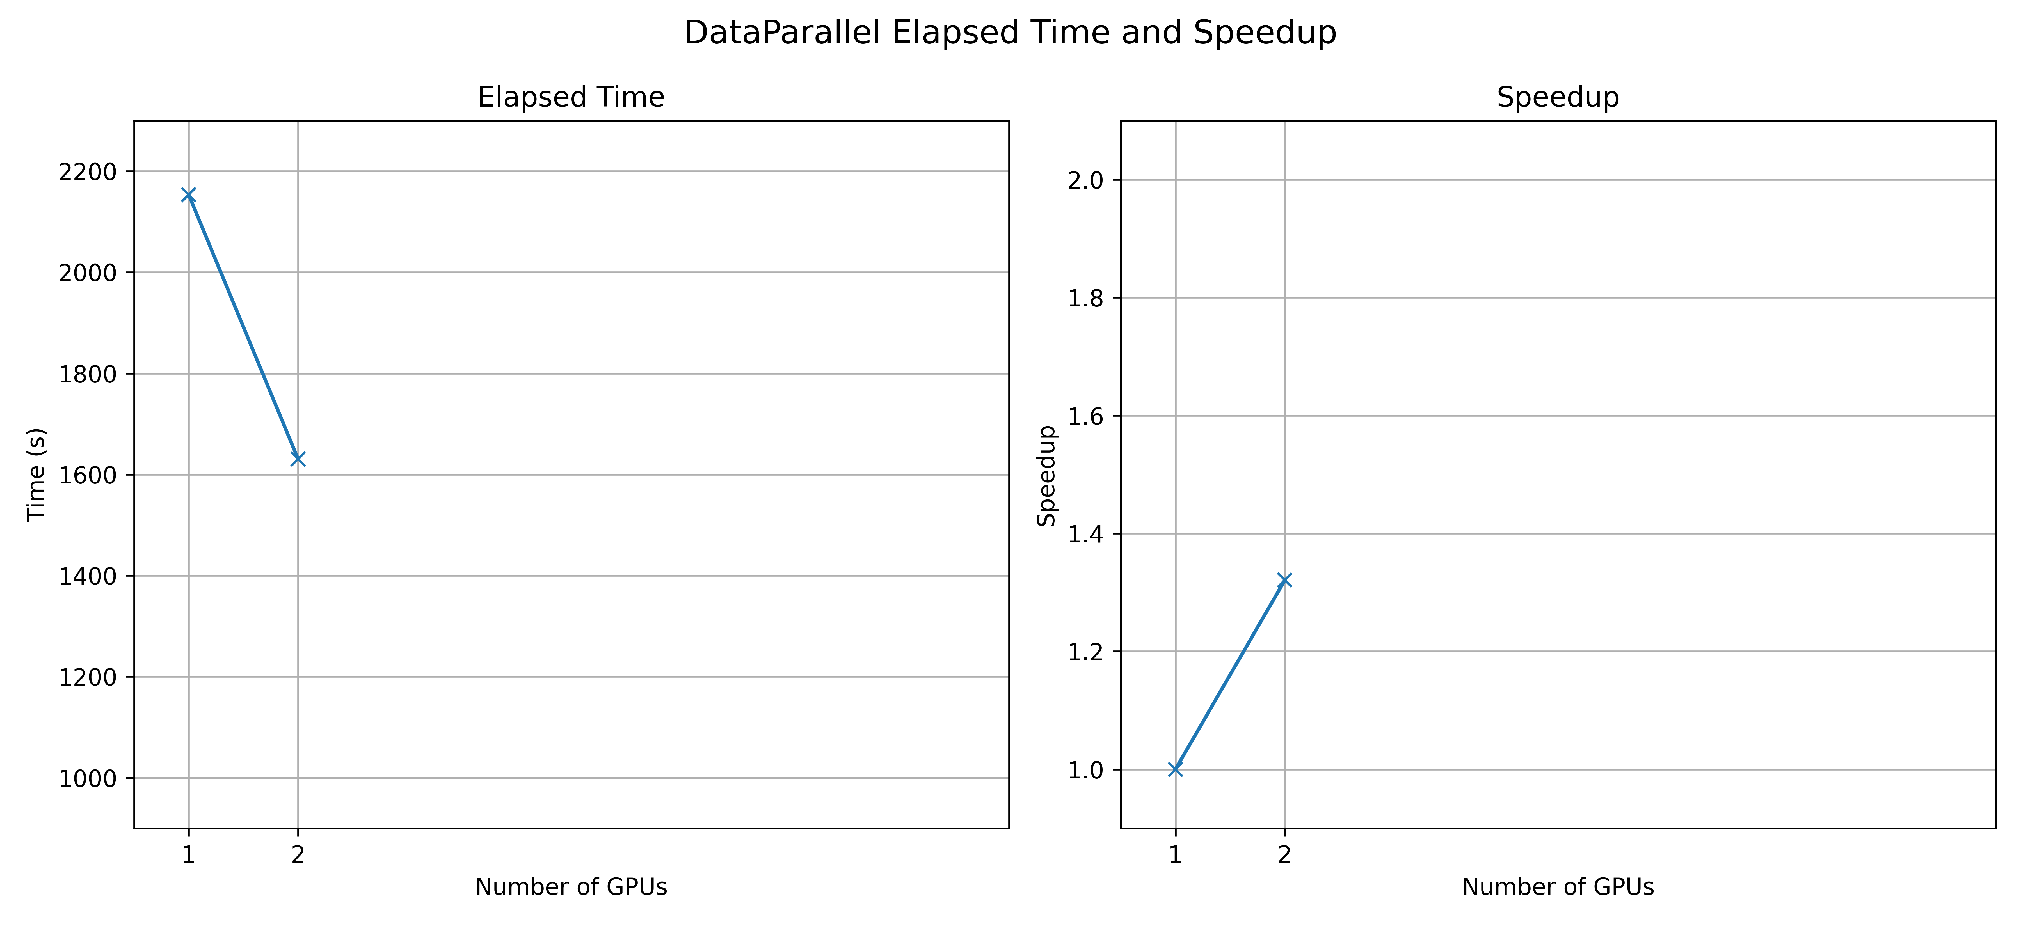
4 Result & Analysis
Using Multi-thread (DataParallel)
Count of GPU | Elapsed time (s) | Speedup
Serial (1 GPU) | 2153.4935 | 1
2 GPU | 1630.4431 | 1.3208
4 GPU | - | -
4.2 Pre-training
Comparison

Slide 26
4 Result & Analysis
Comparison Summary
4.2 Pre-training
Training | Resources | Elapsed Time (s) | Speedup
Serial | Main process | 2153.4935 | 1
Multi-process (workers) | 2 processes | 1169.8231 | 1.8409
 | 4 processes | 1114.2052 | 1.9328
 | 8 processes | 1113.5024 | 1.9340
Multi-thread (DataParallel) | 2 GPUs | 1630.4431 | 1.3208
 | 4 GPUs | - | -
DistributedDataParallel

Slide 27
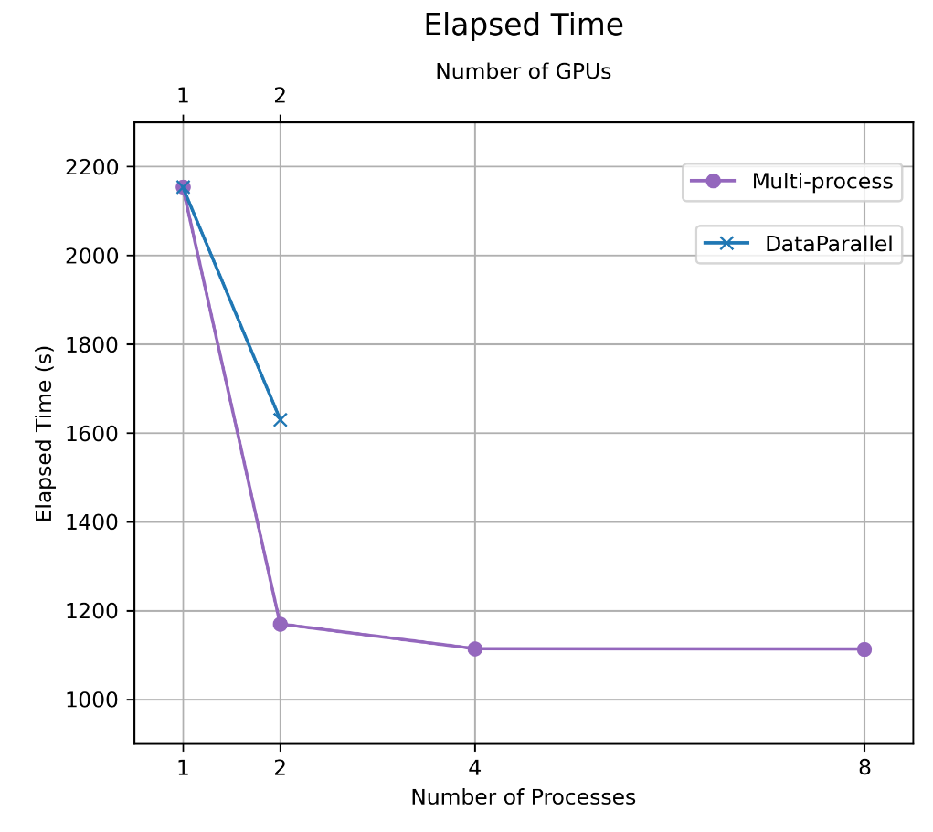
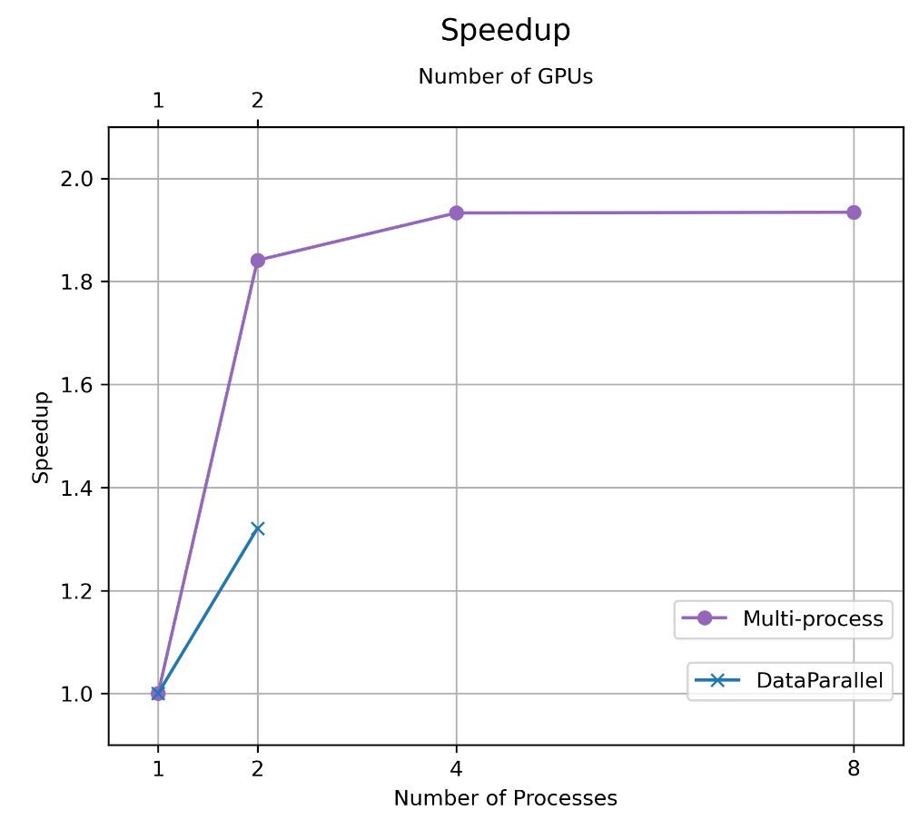
4 Result & Analysis
Comparison Summary
4.2 Pre-training

Slide 28
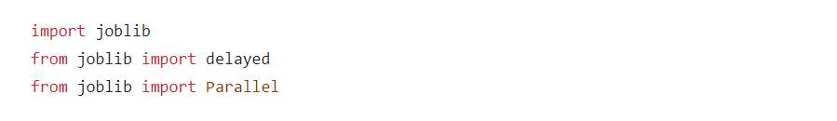
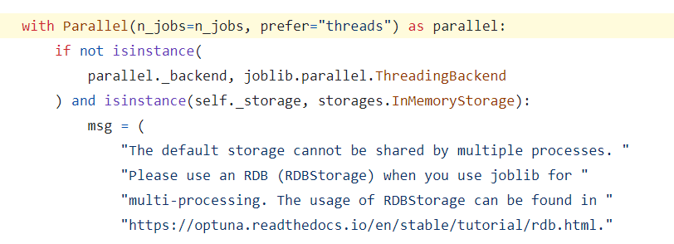
4 Result & Analysis
4.3 Hyperparameter Tuning
Parallel Mechanism
Optuna study
Apply parallelism using
Joblib threading
Hyperparameters we tuned:
learning rate
step size
weight decay
momentum

Slide 29
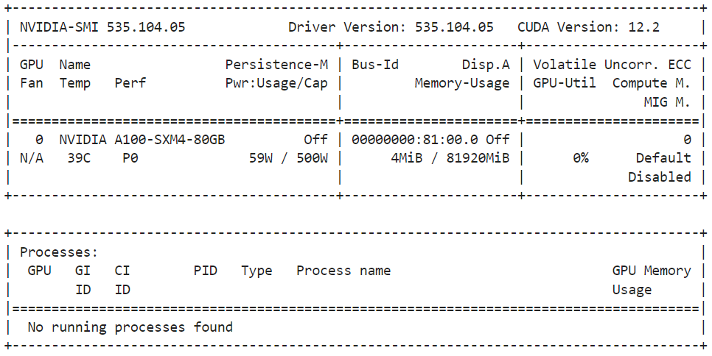
4 Result & Analysis
4.3 Hyperparameter Tuning
Hardware
CPU
AMD EPYC 7543 32-Core Processor
Architecture: X86_64
Count: 4
GPU
A100-SXM4-80GB
Count: 1

Slide 30
4 Result & Analysis
4.3 Hyperparameter Tuning
thread
1
threads
2

Slide 31
4 Result & Analysis
4.3 Hyperparameter Tuning
threads
4
threads
8

Slide 32
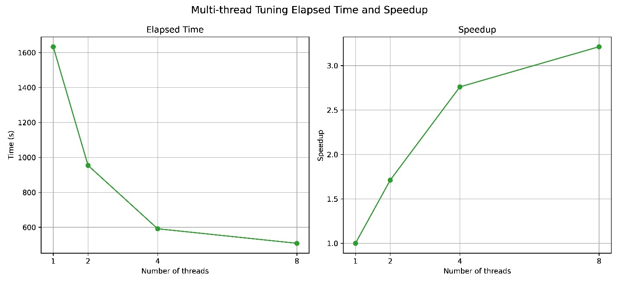
4 Result & Analysis
Count of Threads | Total Elapsed time (s) | speedup
Serial (1 thread) | 1633.4193 | 1
2 threads | 954.1967 | 1.7118
4 threads | 591.6575 | 2.7608
8 threads | 508.3633 | 3.2131
4.3 Hyperparameter Tuning

Slide 33
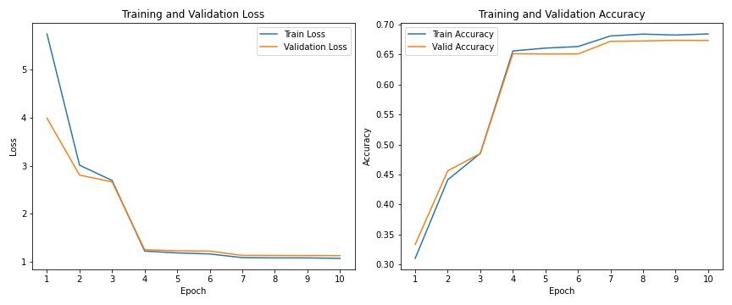
4 Result & Analysis
4.4 Final Training & Model Evaluation
Training acc: 68.43%
Validation acc: 67.36%

Slide 34
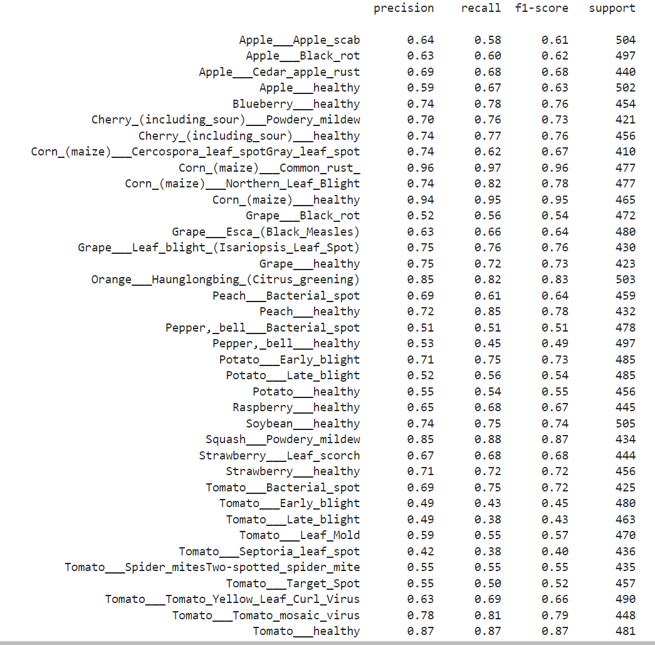
4 Result & Analysis
4.4 Final Training & Model Evaluation
Test acc: 67.33%

Slide 35
5 Conclusion
In data preprocessing
Both frameworks effectively harness parallel processing to expedite computations and enhance overall efficiency.
Compared to Dask, PyTorch exhibits a more substantial time reduction compared to Dask during data preprocessing tasks.
In model training
Utilizing multiprocessing yields speedup improvements, but diminishing returns occur when processes exceed CPU core count.
Increased GPU count with DataParallel accelerates training times, though multiprocessing outperforms in terms of performance.
In hyperparameters tuning
Optuna demonstrates notable speedup improvements in hyperparameter tuning with an increasing number of threads.

Slide 36

References
Gula, L. T. (2023, February 6). Researchers helping protect crops from pests. National Institute of Food and Agriculture. https://www.nifa.usda.gov/about-nifa/blogs/researchers-helping-protect-crops-pests
Ingle, A. (2020, December 15). Plant disease classification - resnet- 99.2%. Kaggle. https://www.kaggle.com/code/atharvaingle/plant-disease-classification-resnet-99-2
Brownlee, J. (2019, July 5). How to manually scale image pixel data for deep learning. MachineLearningMastery. https://machinelearningmastery.com/how-to-manually-scale-image-pixel-data-for-deep-learning/
Schmitt, M. (n.d.). Understanding dask architecture: Client, scheduler, workers. Datarevenue. https://www.datarevenue.com/en-blog/understanding-dask-architecture-client-scheduler-workers.
Modi, R. (2022, February 25). ResNet - understand and implement from scratch. Medium. https://medium.com/analytics-vidhya/resnet-understand-and-implement-from-scratch-d0eb9725e0db
Datasets & dataloaders. Datasets & DataLoaders - PyTorch Tutorials 2.1.1+cu121 documentation. (n.d.). https://pytorch.org/tutorials/beginner/basics/data_tutorial.html
Zhu, J. (n.d.). Getting started with distributed data parallel. Getting Started with Distributed Data Parallel - PyTorch Tutorials 2.2.0+cu121 documentation. https://pytorch.org/tutorials/intermediate/ddp_tutorial.html

